Slide 1


AI & ML for Process Analytical Technology using Python Day 2: Exploratory data analysis and visualization
João Coutinho
CInTech: Polo Tecnológico de Inovação, Translação e Industrialização de Medicamentos Injetáveis Complexos
Projeto nº 30 – Referência 7131, (Código do projeto: C644865576-00000005)

Slide 2
Data collection and acquisition
Excel spreadsheets, .csv files
SQL databases/historians
Extract data from databases
Extract data from databases or spreadsheets
Data storage
On-line sensors or off-line laboratory analysis
Experiments
Transform or clean data for analysis
Exploratory data analysis
Statistical analysis (univariate and multivariate)
Data visualization
Define goals and hypothesis
What to want to predict?
What to use for prediction?
Build models
Decision making
Define modeling hypothesis
Is the model good for our goals?
Day 2
Day 2

Slide 3
Day 2 overview
Part 1: Univariate statistical analysis
Data visualization, frequency statistics
Probability distributions
Summary statistics
Part 2: Data analysis and manipulation with Pandas
Loading and saving datafiles
Data selection and transformation
Plotting
Part 3: Multivariate data analysis
Correlation and covariance
Multivariate distributions
Part 4: Principal Component Analysis and applications

Slide 4
Part 1: Univariate statistical analysis

Slide 5
Univariate statistical analysis - introduction
Deterministic systems are not subject to change (e.g. noise-free computer simulations)
However, typical real-world phenomena are not determinstic but instead stochastic
A random variable is a variable whose value is determined by the outcome of a stochastic or random phenomenon
There are different types of random variables:
Continuous real-valued variables (can take both negative and positive values)
Positive variables
Integer/Discrete/Qualitative variables

Slide 6
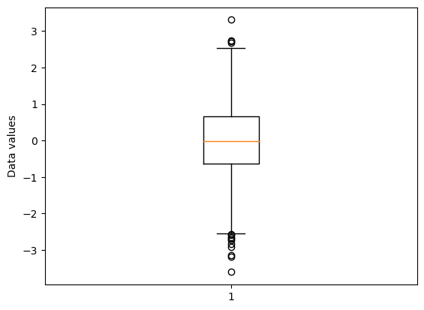
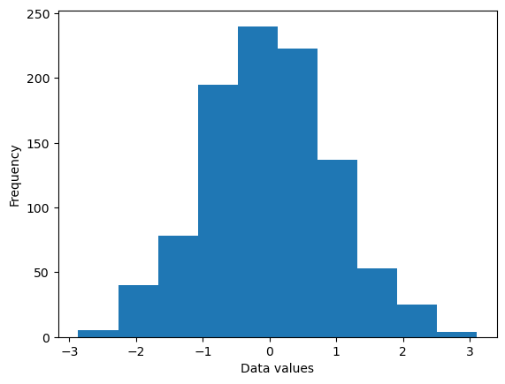
Univariate statistical analysis - introduction
Histograms and boxplots are a good way to visualize the distribution of observed data

Slide 7
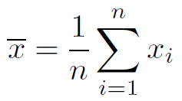
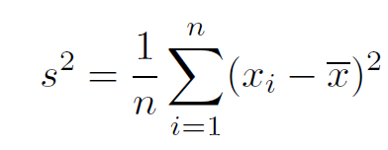
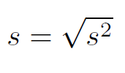
Univariate statistical analysis
Data can be characterized with different statistical measures:
Central tendency (what is the ‘typical’ value)
Mean - average value
Mode – value with the highest frequency
Median – value that splits the data into a lower and upper half
Variability (how ‘spread out’ are the values)
Variance
Standard deviation
Kurtosis and skewness (later)
Mean
Variance
Standard deviation

Slide 8
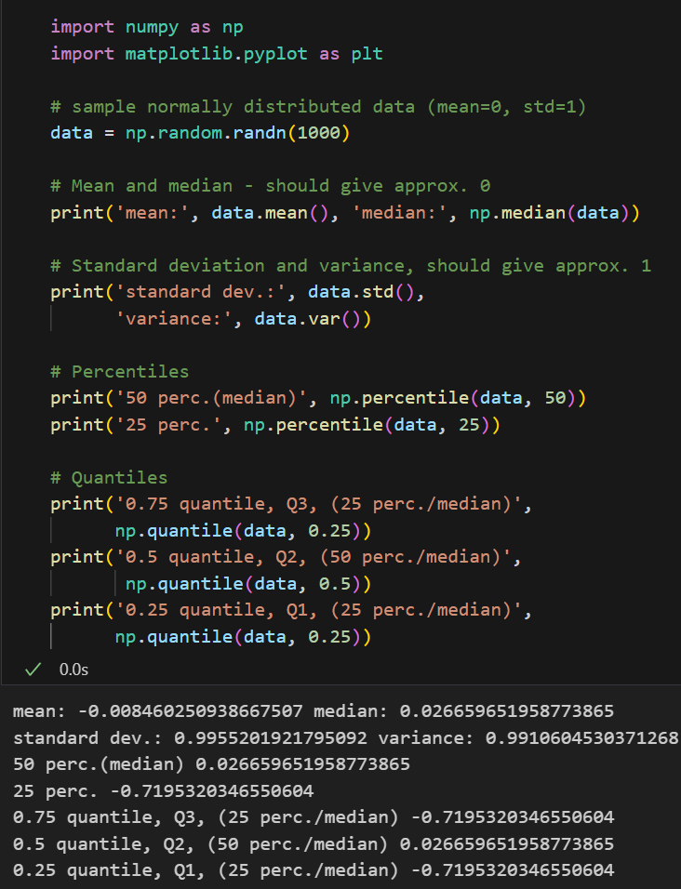
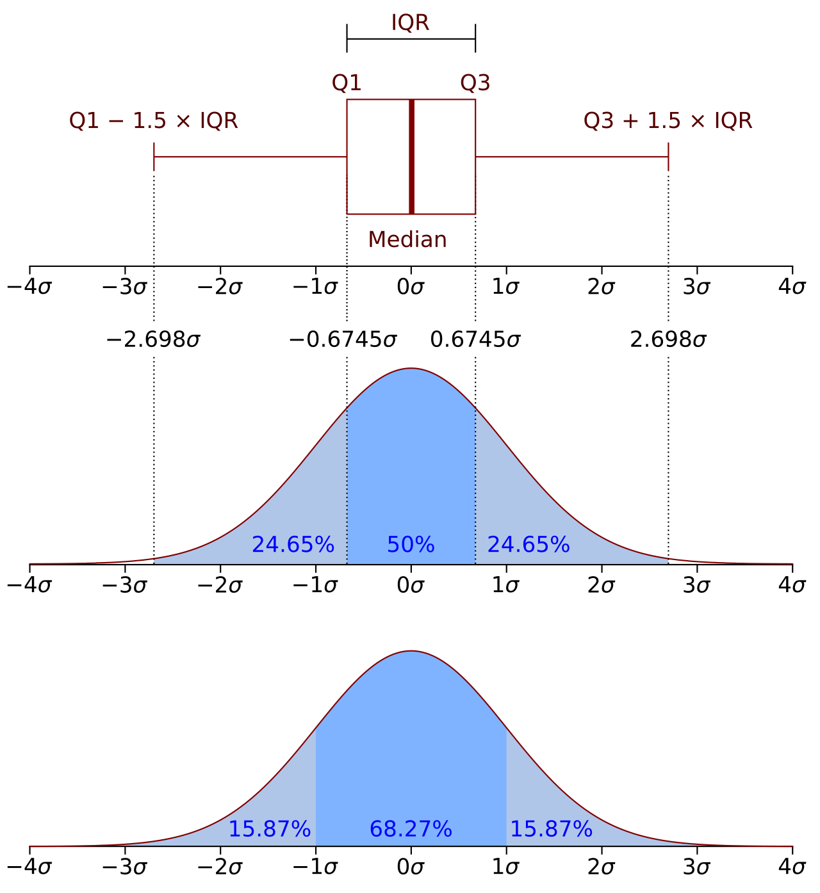
Univariate statistical analysis

Slide 9
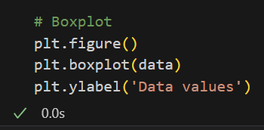
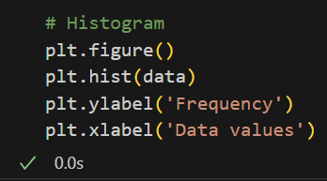
Univariate statistical analysis

Slide 10
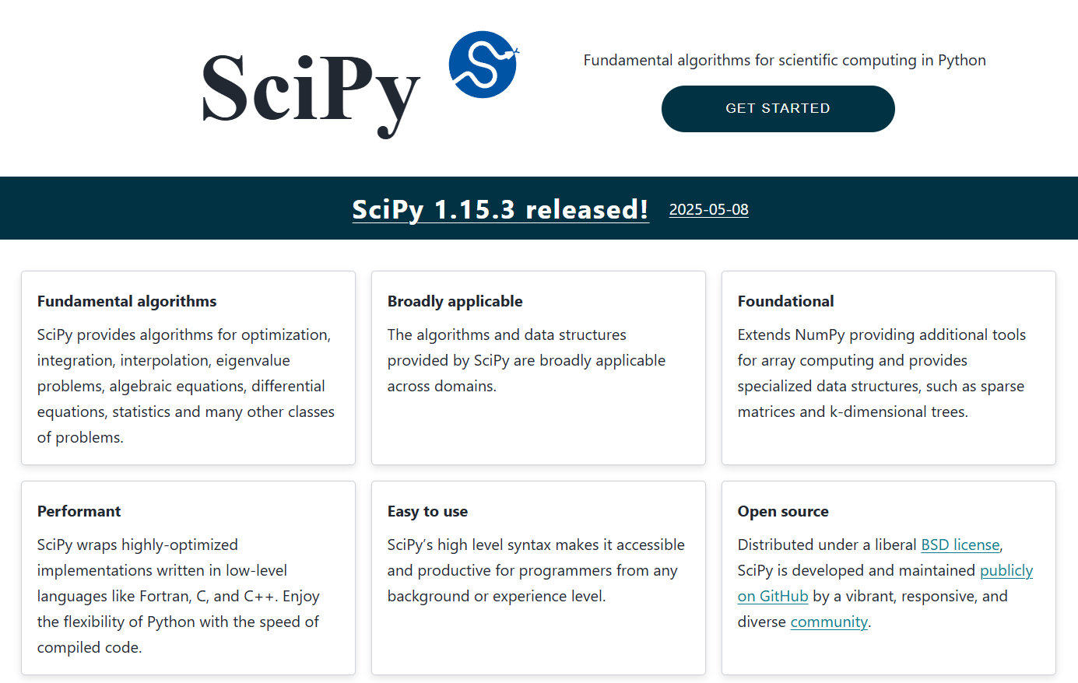
Univariate statistical analysis – introduction to scipy
Scipy is a Python library for basic and advanced scientific computing
Import following packages

Slide 11
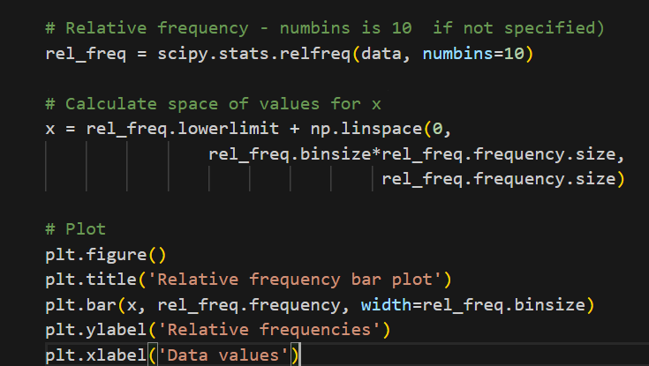
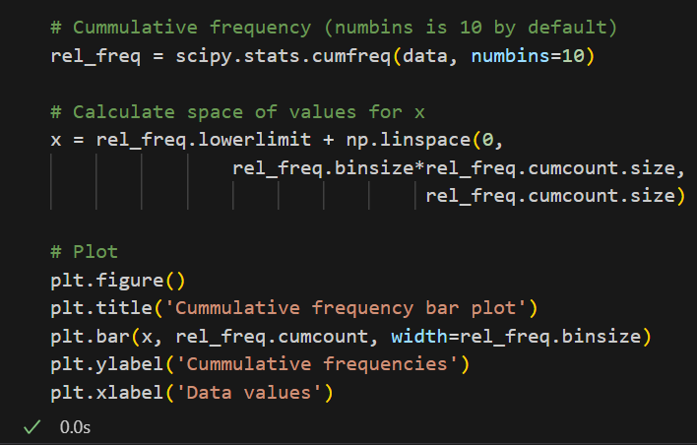
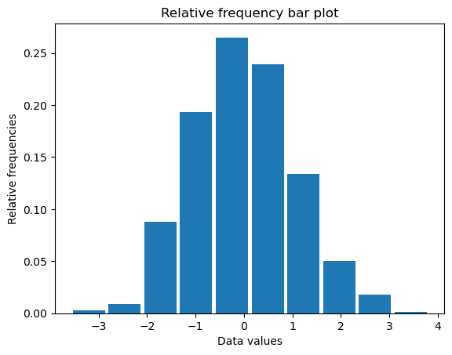
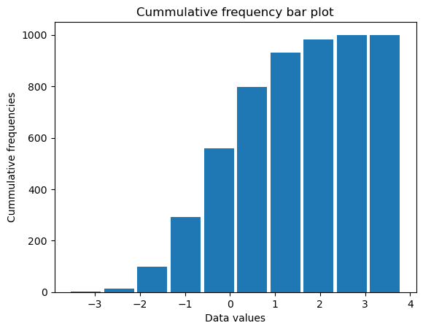
Univariate statistical analysis – relative and cumulative frequency

Slide 12
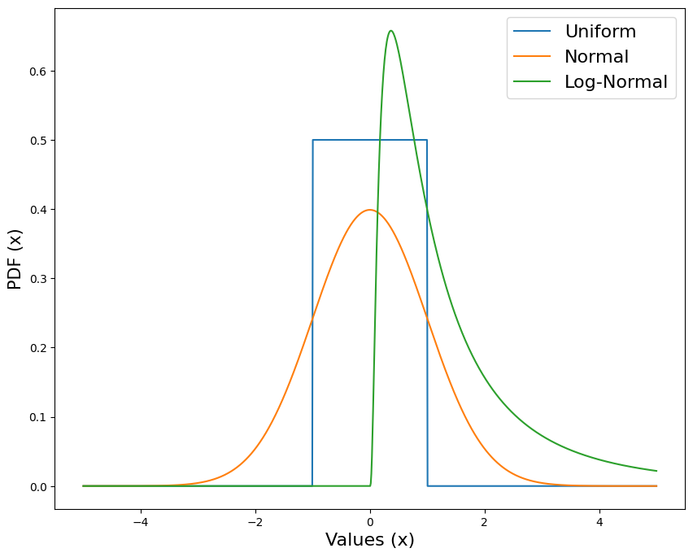
Univariate statistical analysis – probability distribution
A probability distribution is a mathematical description of the probability of a random variable
We can have:
continuous (daily temperature, stock price) distributions
discrete (pass/fail trials, coin tosses) distributions
Probability distributions are tipically illustrated using the Probability Density Function (PDF)
Three relevant continuous distributions are:
Uniform (simulation)
Normal (continuous variables)
Log-normal (positive variables, particle distributions)

Slide 13
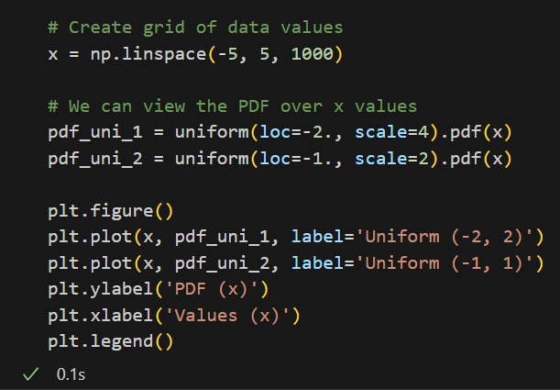
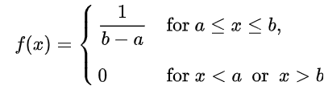
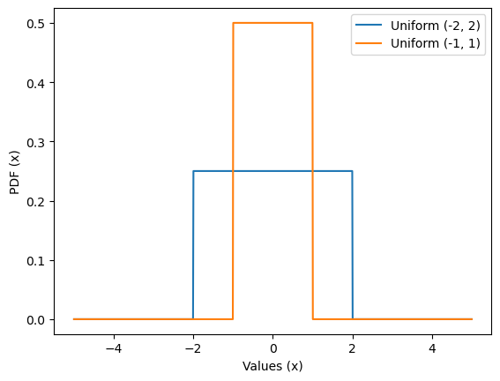
Univariate statistical analysis – Uniform distribution
The uniform distribution is tipically only useful in simulation settings
Every value between a lower and upper limit has exactly the same probability
Changing the upper and lower parameters spreads out the distribution

Slide 14
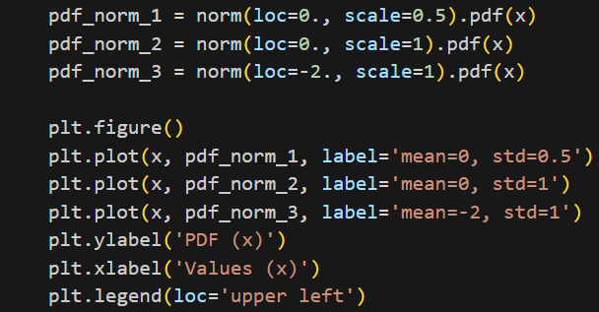
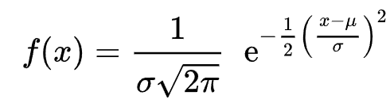
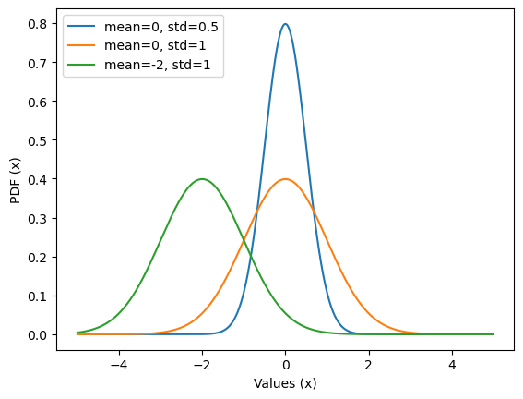
Univariate statistical analysis – Normal distribution
Normal (Gaussian) is the most used distribution in statistics
Symmetric “bell” shaped distribution
The mean, mode and median all coincide at the peak of the distribution
Changing the mean changes the location of the peak
Changing the standard deviation “shrinks” or “spreads” the distribution

Slide 15
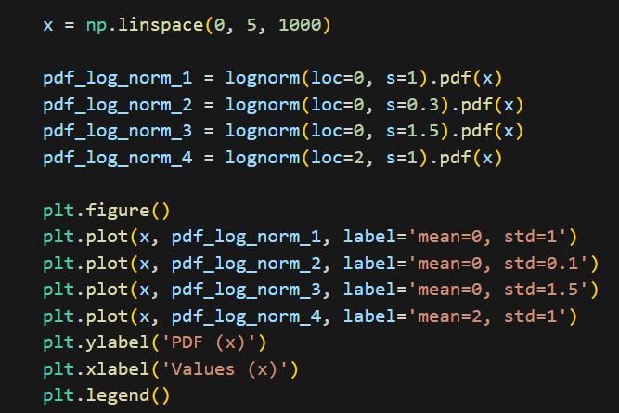


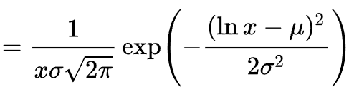

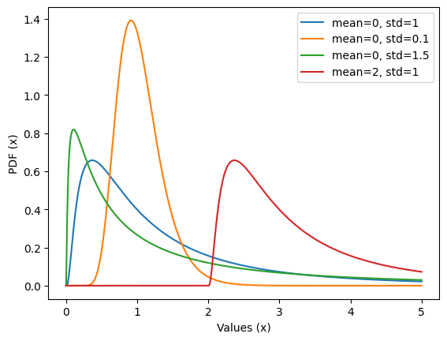
Univariate statistical analysis – Log-normal distribution
A log-normal random variable is a positive variable where its natural logarithm is normally distributed
Unlike the normal distribution, it is not symmetric
Increasing the standard deviation ‘tilts’ the distribution to the left
Log-normal distributions are typically used to describe particle size distributions

Slide 16
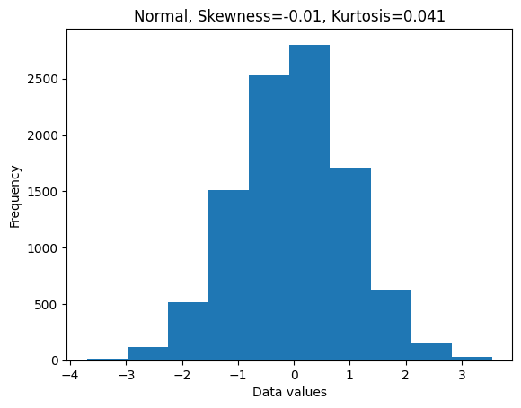
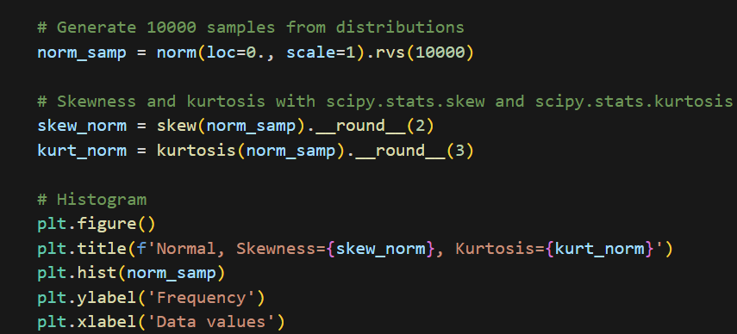
Univariate statistical analysis – Skewness and kurtosis
Skewness indicates the asymetry of the distribution – if data tilts to the left or right
Kurtosis quantifies the ‘flatness’ and “spreading” of the distribution – if the distribution ‘tails’ are large

Slide 17
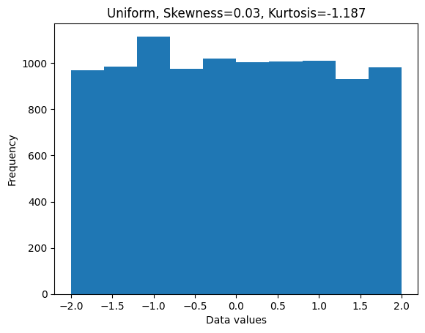
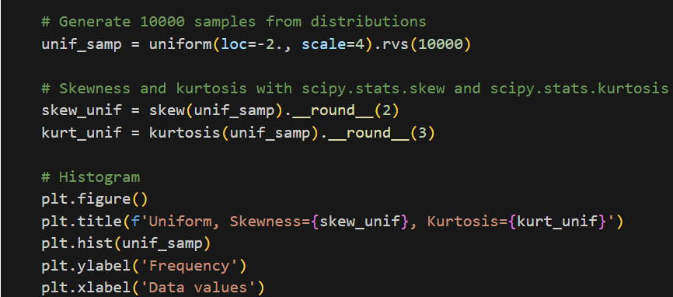
Univariate statistical analysis – Skewness and kurtosis
Skewness indicates the asymetry of the distribution – if data tilts to the left or right
Kurtosis quantifies the ‘flatness’ and “spreading” of the distribution – if the distribution ‘tails’ are large

Slide 18
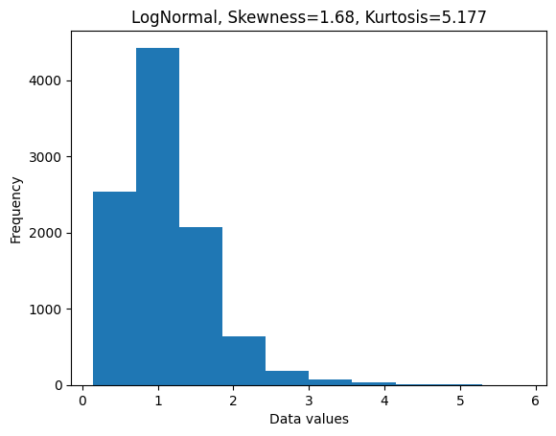
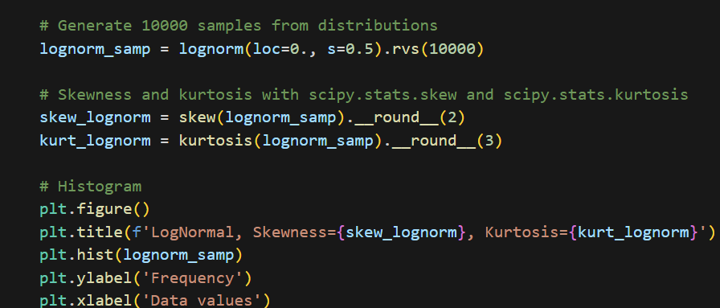
Univariate statistical analysis – Skewness and kurtosis
Skewness indicates the asymetry of the distribution – if data tilts to the left or right
Kurtosis quantifies the ‘flatness’ and “spreading” of the distribution – if the distribution ‘tails’ are large

Slide 19
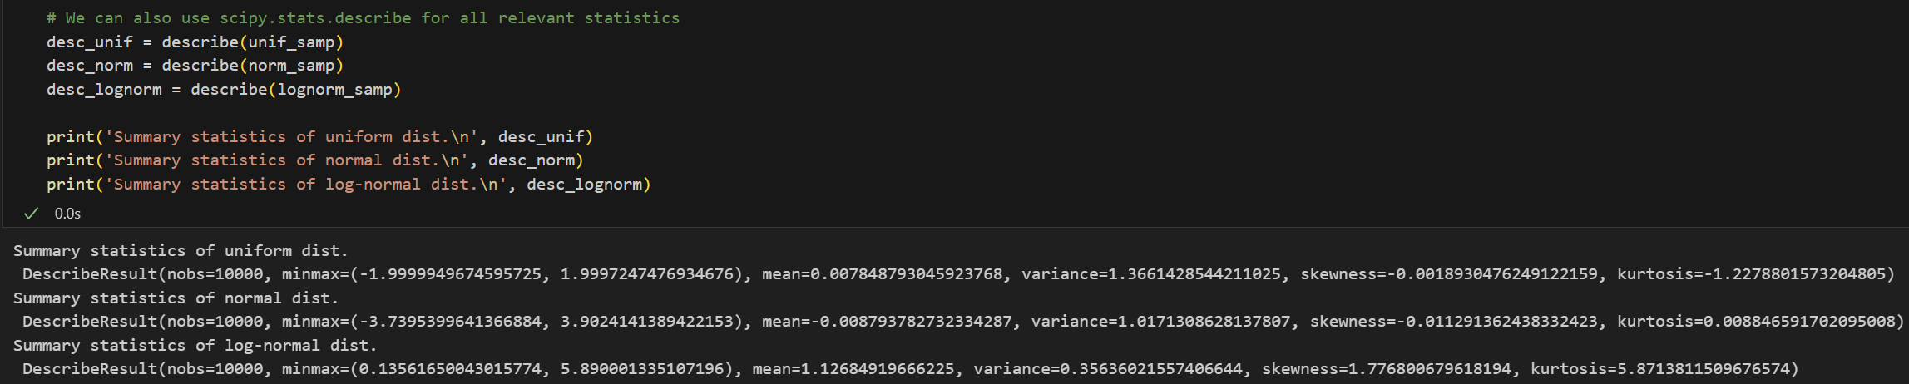
Univariate statistical analysis – summary data description
Describe method from scipy.stats gives quick summary statistics of the data

Slide 20
Part 2: Data analysis and manipulation with Pandas

Slide 21
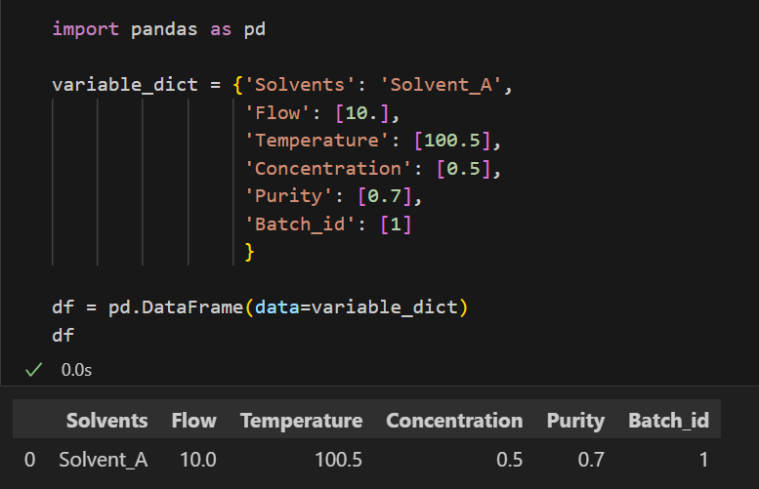
Pandas - introduction
Pandas is a fast, powerful, flexible and easy to use open-source data analysis and manipulation tool
It is built on top of numpy, scipy and matplotlib
Works very well with .csv data and Excel files, allows for very fast exploratory data analysis

Slide 22
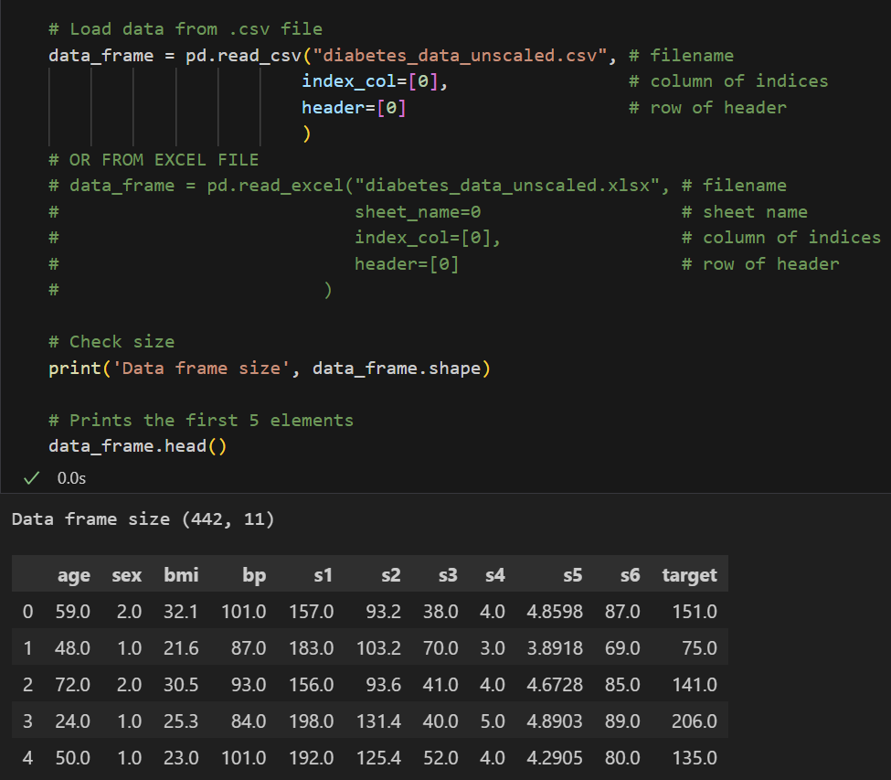
Pandas - Loading data from .csv file or Excel spreadsheet

Slide 23
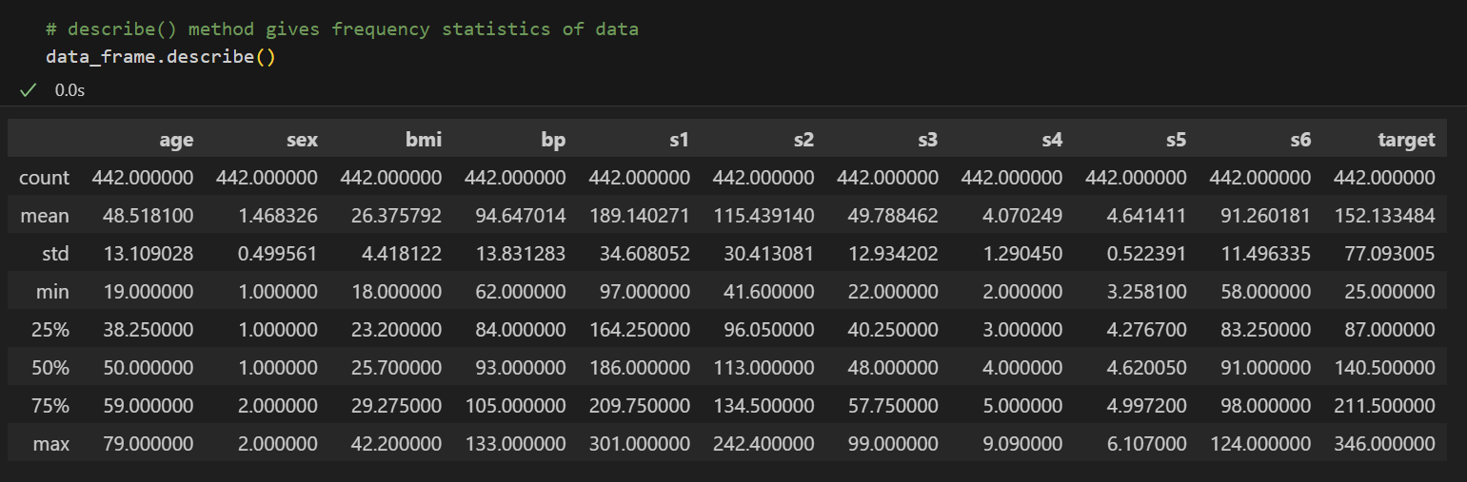
Pandas – describe data
Describe is a simple and useful first pass at the dataset

Slide 24
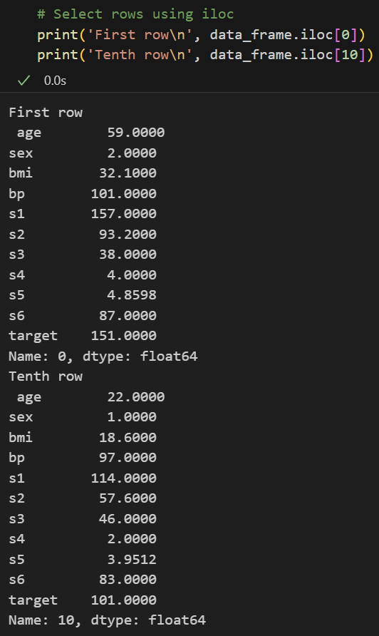
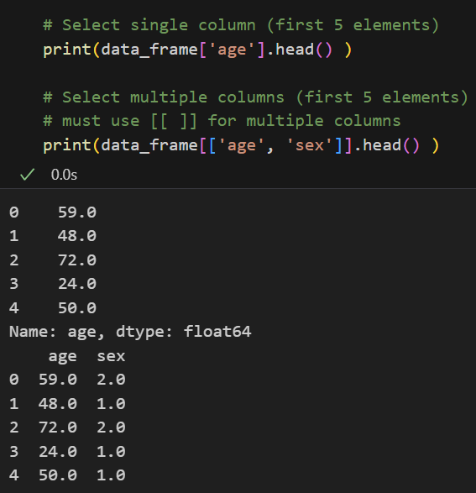
Pandas – data selection and indexing

Slide 25
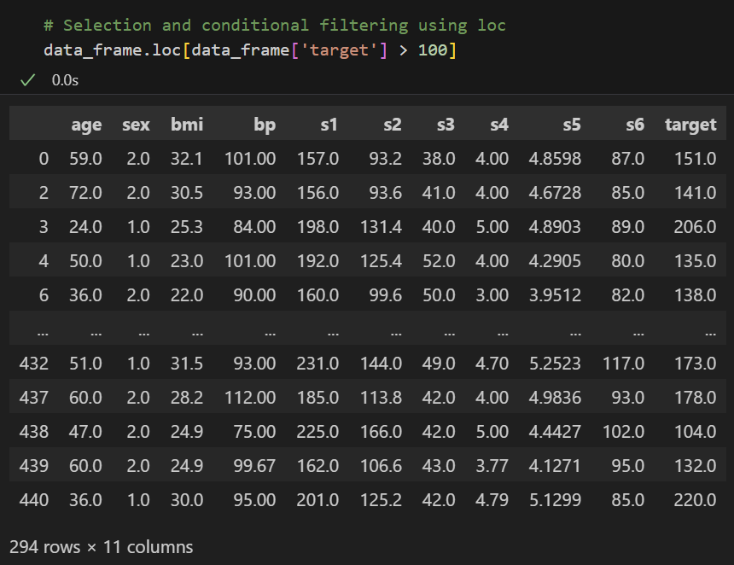
Pandas - Conditional filtering using loc

Slide 26
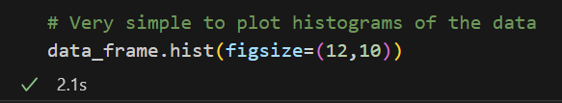
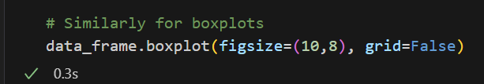
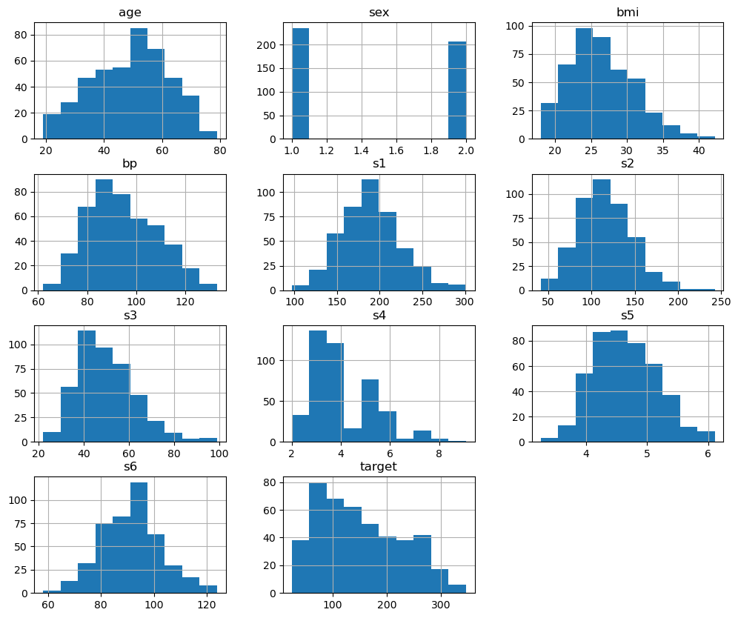
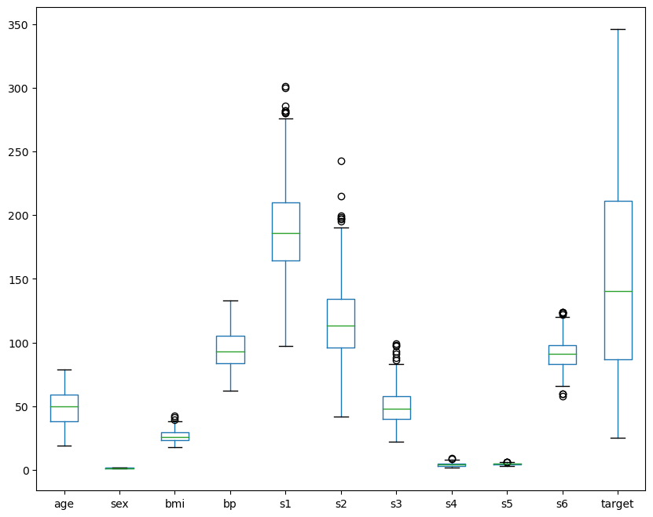
Pandas – plotting and visualization

Slide 27
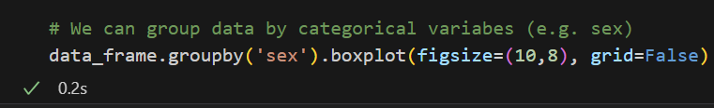
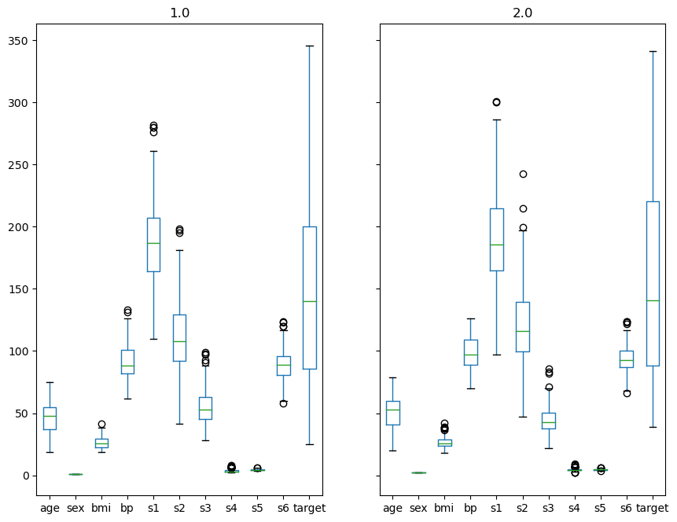
Pandas – groupby and ploting

Slide 28
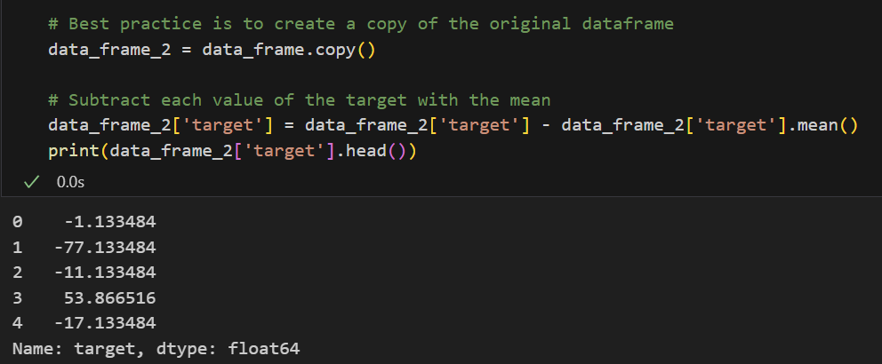
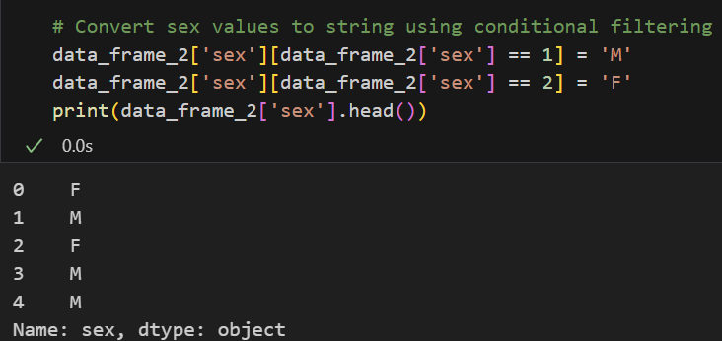
Pandas – data manipulation and transformation

Slide 29
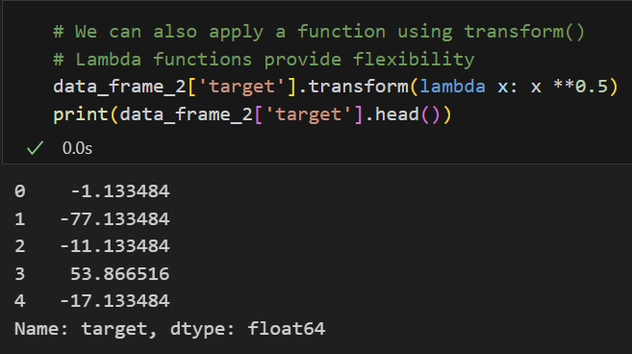
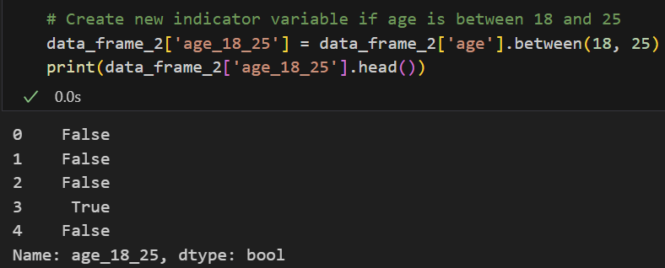
Pandas – data manipulation and transformation

Slide 30
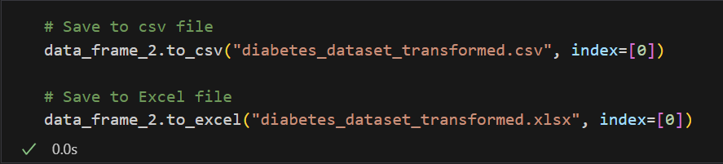
Pandas – saving data
After applying the desired transformations to the data, the new data can be saved to a .csv or Excel file

Slide 31
Part 3: Multivariate statistical analysis

Slide 32
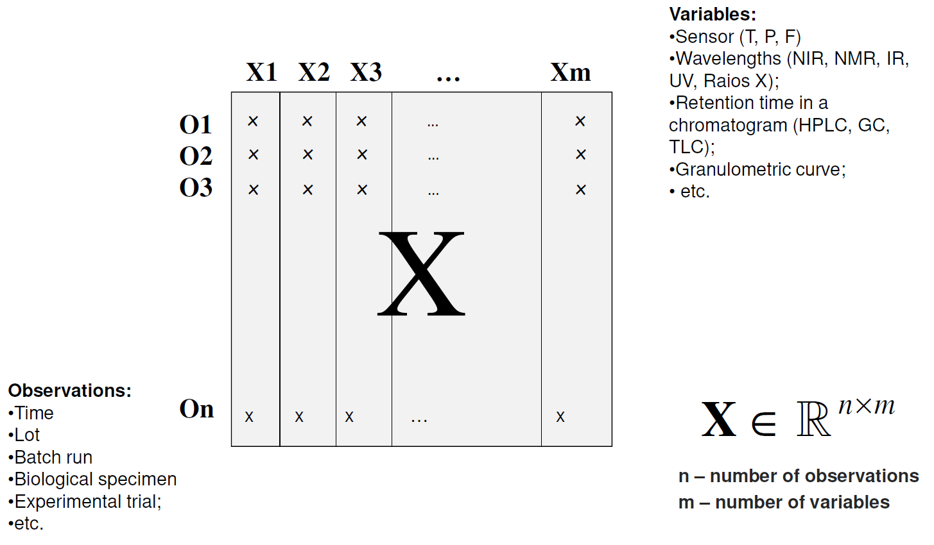
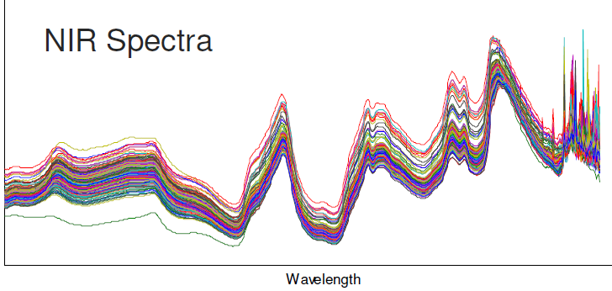
Multivariate statistical analysis - motivation
Data is not tipically univariate, but instead of rich and multivariate nature
Spectroscopic data is obvious example of multivariate data (hundreds to thousands of variables)
If each wavelength absorbance is a considered a variable, we can easily have 1000s of variables

Slide 33



Multivariate statistical analysis
We analyzed different variables independently (uncorrelated) and one at a time (univariate statistics)
In many cases, variables are not independent but instead correlated
Multivariate statistics deals with the analysis of multivariate data and distributions

Slide 34

Multivariate statistical analysis – covariance and correlation
Covariance measures how two or more random variables vary change in relation to one another
Covariance matrix gives the relationships between two variables
Pearson correlation coefficient can also be used to estimate the strength of the correlation between two variables
Pearson ~= -1 -> Negative correlation
Pearson ~0 -> No correlation
Pearson ~= 1 -> Positive correlation

Slide 35



Multivariate statistical analysis – correlation and covariance

Slide 36


Multivariate statistical analysis – correlation and covariance

Slide 37


Multivariate statistical analysis – non-linear correlation
We have to be careful when two variables have non-linear correlation or there are outliers
For these cases, use Spearman correlation (monotonic correlated variables)
Always try look at the data, do not base decisions solely on correlation coefficients
Outlier
Pearson corr. does not capture non-linear trend
A single outlier changes the value of Pearson corr. coefficient

Slide 38


Multivariate statistical analysis – non-linear correlation

Slide 39



Multivariate statistical analysis – Multivariate Normal distribution
Multivariate normal distribution is an extension of the normal distribution to 2 or more random variables
Instead of a single mean and standard deviation, we have a mean vector and covariance matrix
It gives the joint probability for na arbitrary number of K variables

Slide 40

Multivariate statistical analysis – Multivariate Normal distribution
Create a helper function for generating data from a Multivariate Normal distribution
This will be useful for next slides

Slide 41





Multivariate statistical analysis – Multivariate Normal distribution
Increasing the diagonal elements of the covariance matrix “spreads” the data
Data is still uncorrelated

Slide 42





Multivariate statistical analysis – Multivariate Normal distribution
Changing the off-diagonal elements “manipulates” the correlation direction

Slide 43
Part 4: Principal Component Analysis and applications

Slide 44


Advanced correlation plots with Pandas and Seaborn
Seaborn can be used to view pairwise correlation plots from data – 1 line of code
Integrates well with Pandas dataframes

Slide 45

How to see correlation in high dimensions?
X1
X10
X926
We can visually assess correlation between pairs of variables to detect patterns
What if we have many variables?
Motivating example:
VIS-NIR spectroscopic data of beer samples
926 absorbance measurements at each wavelength – 926 variables
How do we assess correlation between measurements at each wavelength?

Slide 46

How to see correlation in high dimensions?
Consider a case of 2 correlated variables
Can we find a subset of uncorrelated projections (orthogonal variables) that capture the data variability ?
Solution: Principal Component Analysis

Slide 47

Principal Component Analysis - introduction
PCA projects the data into a lower dimensional latent variable space – Principal Components (PC)
The covariance matrix (which gives the correlation) is decomposed using linear algebra techniques
Components are uncorrelated ordered based on explained variability: PC 1, PC 2, …
We can have as many PCs as variables – but we want a low number of PCs for dimensionality reduction
Data = Scores x Loadings + Residuals
M – number of PCs (or latent variables)
Structured variability
Unstructured variability

Slide 48
Principal Component Analysis – suggested steps
1
Apply PCA to data with large number of components
2
Select number of components to retain
3
Apply PCA to data with selected number of components
4
Use PCA for dimensionality reduction, pattern analysis or outlier identification

Slide 49


Principal Component Analysis – application to spectroscopic data
PCA is sensitive to the differences in scale between variables
Tipically for non-sequential process data we apply autoscaling – subtract mean, divide by standard deviation
For spectroscopic data, mean centering is reccomended – each individual spectra is divided by the mean spectra
Mean centering

Slide 50

Principal Component Analysis – application to spectroscopic data
PCA effectively reduces the dimension of the data under analysis (900 variables to 1-2 latent variables)
The correlation in the beer spectra is inherently lower dimensional – 1 component explains 92% of data variability

Slide 51

Principal Component Analysis – application to spectroscopic data
How to choose number of principal components?
For spectroscopic data - visual inspection of latent variable loading vectors
Explained variability: 90%, 95% - Warning: we do not want to capture too much variability when data has noise
Kaiser’s criteria or knee criteria
Parallel analysis
Knee criteria leads to selecting 2 components

Slide 52

Principal Component Analysis – loading plots
PCA loadings provide insights into relationship between different variables
Variables with loadings very different from zero are important for the PCA model
For spectroscopic data, we can plot the loadings for each PC as a function of the wavelength
Loadings give interpretation of the functional patterns in the spectra
This region is not important for the correlation in the data

Slide 53

Principal Component Analysis – score plots
PCA scores give intuition on the relationship between observations/samples
This can be useful to capture patterns between observations or detect outliers
Important notes:
Score analysis is only relevant if PCs capture a large portion of variability
too strong outliers (distant from origin) can distort PCA and subsequent conclusions
Observations are closely related (similar)
Scores indicate these observations are very different from others
They can be thought of “moderate” outliers

Slide 54


Principal Component Analysis – score plots
Based on score plot, we can identify 3 spectras that are “different” from the rest
Plotting these observation reveals a different pattern – a larger peak and offset in the initial wavelengths
This can be used for dividing data into “classes/clusters” or to remove outliers
This shows the power of PCA for pattern analysis and recognition

Slide 55


Principal Component Analysis using Scikit-learn

Slide 56


Principal Component Analysis using Scikit-learn
Scikit-learn auto-selects a large number of PCs (if not specified)

Slide 57

Principal Component Analysis – loading plots

Slide 58

Principal Component Analysis – score plots

Slide 59

Principal Component Analysis – score plots

Slide 60
CInTech: Polo Tecnológico de Inovação, Translação e Industrialização de Medicamentos Injetáveis Complexos
Projeto nº 30 – Referência 7131
(Código do projeto: C644865576-00000005)
Projeto Cintech com a referência 7131 financiado pelo PRR - Plano de Recuperação e Resiliência e pelos Fundos Europeus Next Generation EU, na sequência do AVISO N.º 02/C05-i01/2022, Componente 5 – Capitalização e Inovação Empresarial - Agendas Mobilizadoras para a Inovação Empresarial

